Slide 1
Human Tracking/Counting
CS 6301 Video Analytics
Uchinta Kumar Boddapati
Spring -13

Slide 2
Human Tracking/Counting
Phases involved:
Fix Region of Interest
Scale it by 2x
Prepare difference image
Obtain Foreground Mask
Apply Erosion
( Frame + FG Mask )→ Required Frame
Process Frame and obtain contours
Identify contours whose area is with in the required range
Mark them as 'features'
Track those features using Mean Shift Algorithm
Count when the feature goes out of reach by MSA

Slide 3
Human Tracking/Counting
1. Fix Region of Interest:
After observing the video, a particular region is chosen as the most appropriate place for tracking with least noise.

Slide 4
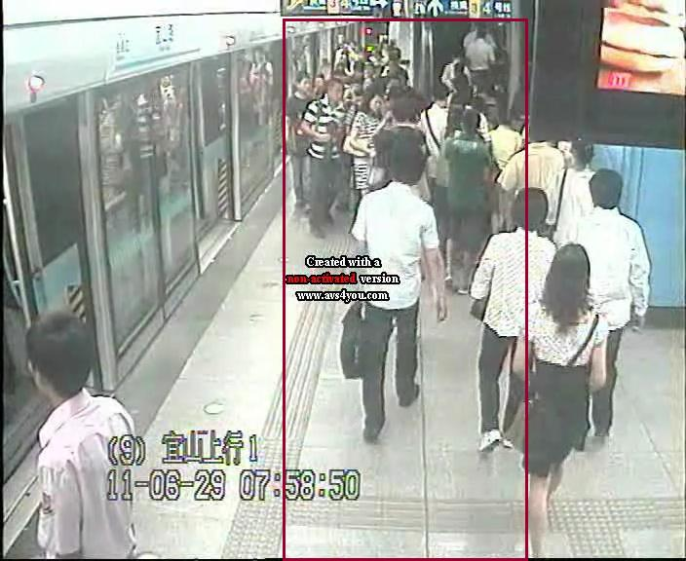
Human Tracking/Counting

Slide 5
Human Tracking/Counting
Scale it by 2x:
It is assumed that, more pixel information might help give more information of a region. And the results are positive to some extent.

Slide 6
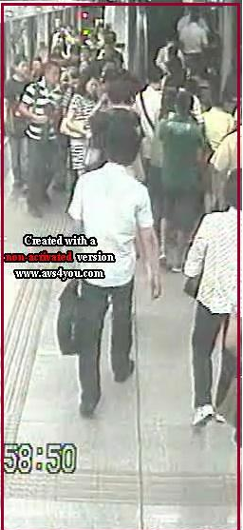

Slide 7
Human Tracking/Counting
Prepare difference image:
BackgroundSubtractorGMG:
Background Subtractor module. Takes a series of images and returns a sequence of mask (8UC1) images of the same size, where 255 indicates Foreground and 0 represents Background. This class implements an algorithm described in "Visual Tracking of Human Visitors under Variable-Lighting Conditions for a Responsive Audio Art Installation," A. Godbehere, A. Matsukawa, K. Goldberg, American Control Conference, Montreal, June 2012.

Slide 8
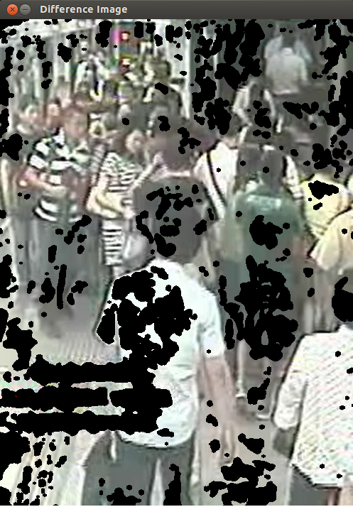

Slide 9
Human Tracking/Counting
Obtain Foreground Mask
A difference image along with a Foreground Mask is returned by the BackgroundGMG algorithm

Slide 10
Human Tracking/Counting
Apply Erosion
To refine and smooth edges, erosion technique is applied on the foreground mask with a 5x5 kernel.

Slide 11
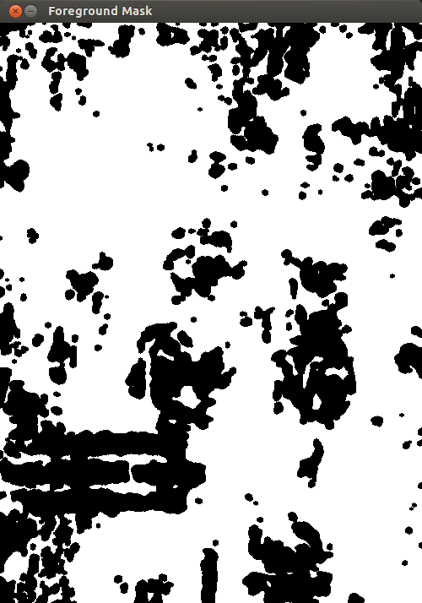

Slide 12
Human Tracking/Counting
( Frame + FG Mask )→ Required Frame
Now the actual frame for processing is obtained

Slide 13
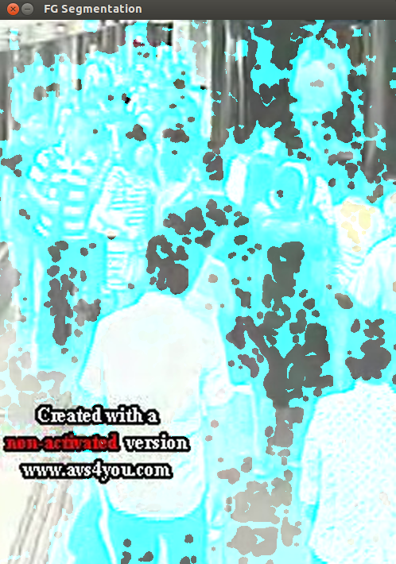

Slide 14
Human Tracking/Counting
Process Frame and obtain contours
The grayed out frame is applied a threshold and contours are obtained

Slide 15
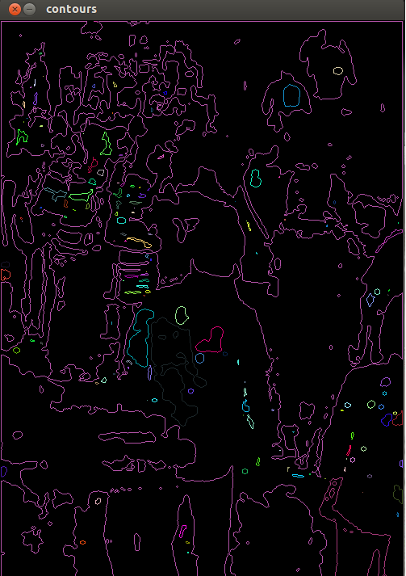

Slide 16
Human Tracking/Counting
Identify contours whose area is with in the required range
The contours obtained are like head, body, legs and a group of people as a single contour. A contour area range is identified to filter out unnecessary contours.

Slide 17
Human Tracking/Counting
Mark them as 'features'
The contours whose area meet the requirement are extracted and information like bounded rectangle, center of the contour are added to the list of features being tracked

Slide 18
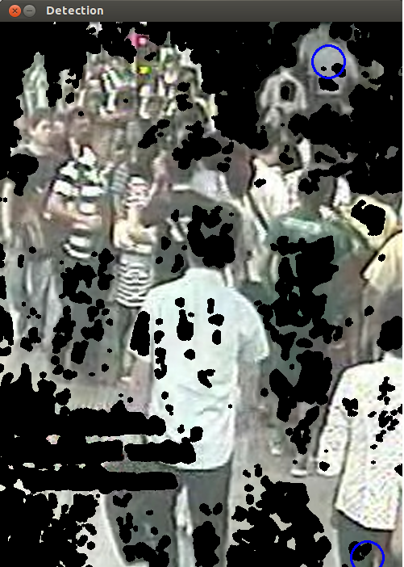

Slide 19
Human Tracking/Counting
Track those features using Mean Shift Algorithm
Each feature-information and current frame is fed to Mean Shift Algorithm to track.

Slide 20
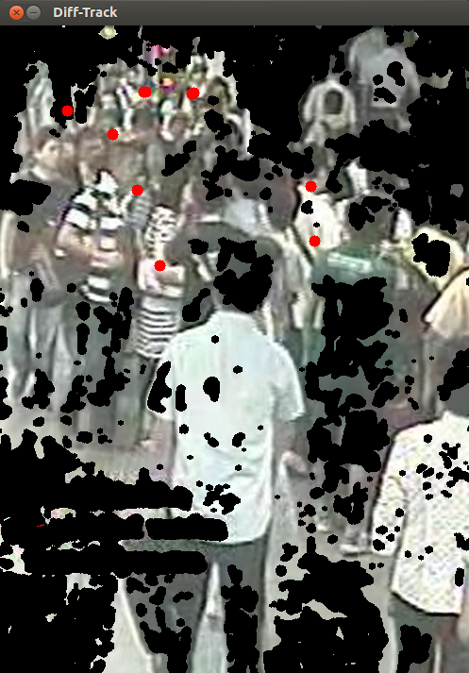

Slide 21
Human Tracking/Counting
Count when the feature goes out of reach by MSA
If MSA is unable to track a feature, it is assumed that feature went out of the frame and a variable 'People Count' is incremented.

Slide 22
Human Tracking/Counting
Assumptions/Faults:
Identifying people in the Region of Interest is sufficient
Some people are not identified as they are part of the group, and the contour for that group is out of the defined range.
Multiple contours for the same person are detected instead of one feature per person.
Sometimes though a feature is in the frame, MSA is unable to track properly because of small contour size
Sometimes feature tracking goes out of track because of multiple histogram match
Thresholding the frame with different values lead to different results.

Slide 23
                Demo

